Slide 1
UNIFIED MODELING LANGUAGE

Slide 2
AGENDA
INTRODUCTION TO VISUAL MODELING
UNIFIED MODELING LANGUAGE
OOAD
SOFTWARE DEVELOPMENT PROCESS
QUESTIONS

Slide 3
INTRODUCTION TO VISUAL MODELING

Slide 4
What is Visual Modeling?
Order
“Modeling captures essential
parts of the system.”
Dr. James Rumbaugh
Item
Ship via
Business Process
Visual Modeling is modeling
using standard graphical notations
Computer System

Slide 5
Visual Modeling Captures Business Process
Use Case Analysis is a technique to capture business process from user’s perspective

Slide 6
Visual Modeling is a Communication Tool
Use visual modeling to capture business objects and logic
Use visual modeling to analyze and design your application

Slide 7
Visual Modeling Manages Complexity

Slide 8
Visual Modeling Defines Software Architecture
User Interface
(Visual Basic,
Java)
Business Logic
(C++, Java)
Database Server
(C++ & SQL)
Model your system
independent of
implementation language

Slide 9
Visual Modeling Promotes Reuse
Multiple Systems
Reusable
Components

Slide 10
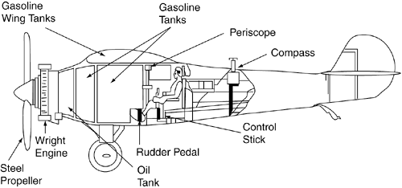
Architecture Modeling
Why Model Architecture?
Architecture Models
Enterprise Architecture (include business processes, org. structures, systems)
System Architecture (include software and hardware components)
Software Architecture (include individual components)

Slide 11


UML Introduction
What Is a Model?
A miniature representation of an object.
A pattern on which something not yet produced will be based.
Why Should I Build Models?
Create a well-documented design so that others who are new to the design can still work with it.
Provides a means to better understand a system.
Why use UML?

Slide 12
UML - Introduction
Diagrams in UML
Structure Diagrams
These diagrams are used to define static architecture.They comprise static constructs such as classes, objects, and components, and the relationships between these elements.
There are six structural diagrams: Package Diagrams, Class Diagrams, Object Diagrams, Composite Structure Diagrams, Component Diagrams and Deployment Diagrams.

Slide 13
UML - Introduction
Diagrams in UML
Behavior diagrams
These diagrams are used to represent dynamic architecture. They comprise behavioral constructs such as activities, states, timelines and the messages that run between different objects. These diagrams are used to represent the interactions among various model elements and instantaneous states over a time period.
There are seven behavioral diagrams: Use Case Diagrams, Activity Diagrams, State Machine Diagrams, Communication Diagrams, Sequence Diagrams, Timing Diagrams and Interaction Overview Diagrams.

Slide 14
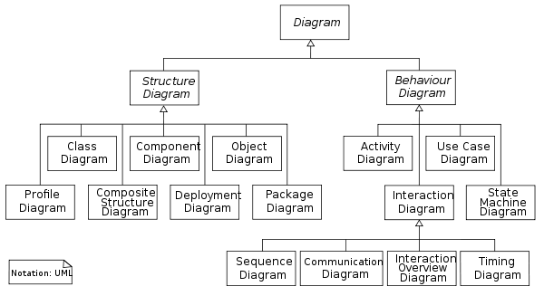
UML - Introduction
1.Static Models
2. Dynamic models

Slide 15
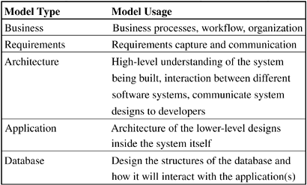
UML - Introduction
What Can I Model with the UML?

Slide 16
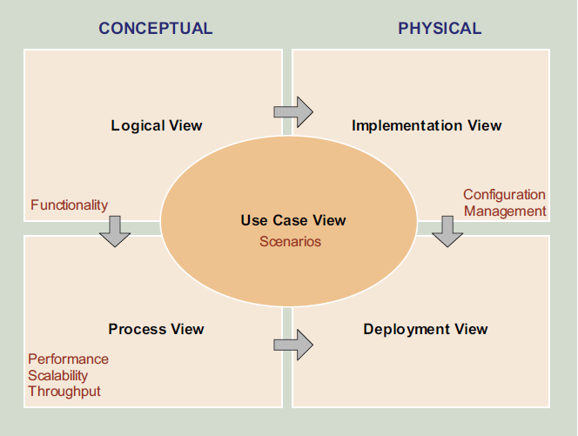
Architecture Modeling - Perspectives
End user
Programmers &
software managers
Integrator
System
Engineer

Slide 17
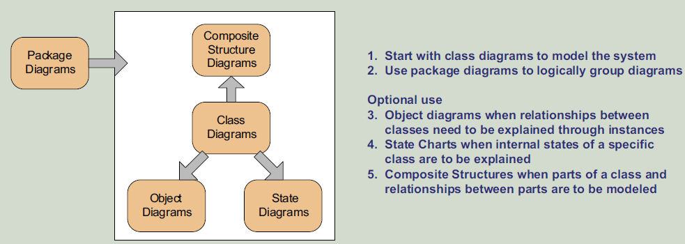
Architecture Modeling – Logical View

Slide 18
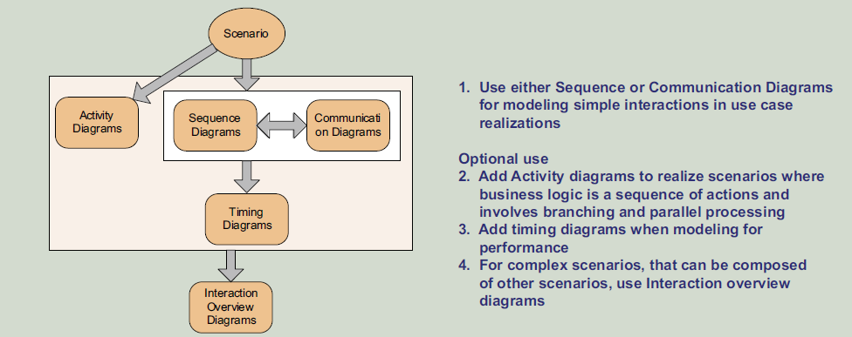
Architecture Modeling – Process View

Slide 19
Architecture Modeling – Implementation View
Implementation or Development View
Component diagrams
This is a view of a system’s architecture that encompasses the components used to assemble and release a physical system. This view focuses on configuration management and actual software module organization in the development environment.
The software is actually packaged into components that can be developed and tested by the development team. While the Logical View is at the conceptual level, the diagrams in this view represent the physical-level artifacts that are built by the team.

Slide 20
Architecture Modeling – Deployment View
Deployment or Physical View
Deployment diagrams
This view encompasses the nodes that form the system’s hardware topology on which the system executes; it focuses on distribution, communication and provisioning.
Deployment Diagrams show the physical disposition of the artifacts in the real-world setting. UML provides constructs to represent Nodes such as devices, execution environment and middleware; artifacts such as jar files and connections; and dependencies between these devices.

Slide 21
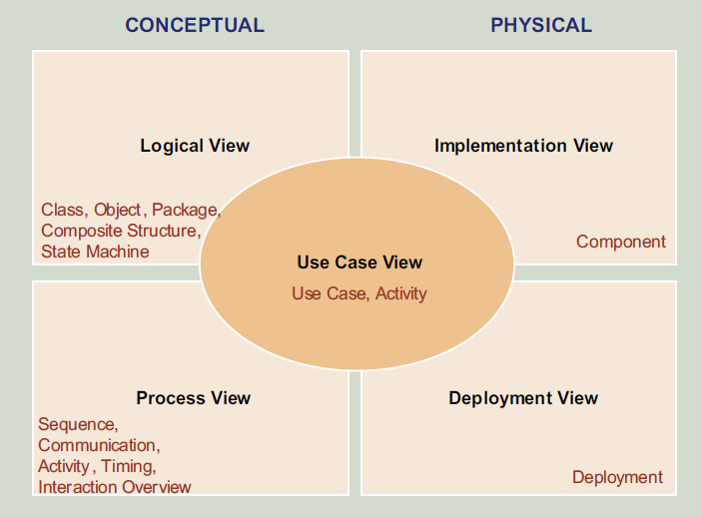
Architecture Modeling - Perspectives
End user
Programmers &
software managers
Integrator
System
Engineer

Slide 22
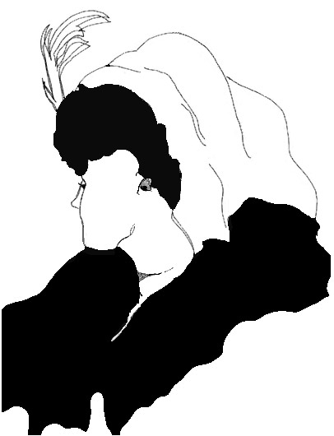
What do you see in the picture ??

Slide 23
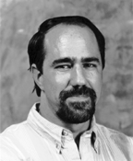

Question – Who is the gentlemen in the picture ??
Grady Booch is one of the original developers of the Unified Modeling Language (UML) and was also one of the original developers of several of Rational's products.
IBM Fellow
http://www.booch.com/architecture/blog.jsp

Slide 24
UNIFIED MODELING LANGUAGE

Slide 25
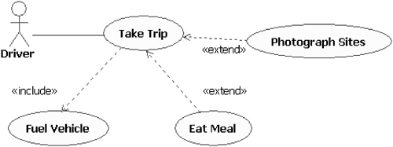
Use Case Modeling
Use Case Diagram
Key Differences Between Include and Extend Relationships
 | Included Use Case | Extending Use Case
Is this use case optional? | No | Yes
Is the base use case complete without this use case? | No | Yes
Is the execution of this use case conditional? | No | Yes
Does this use case change the behavior of the base use case? | No | Yes

Slide 26
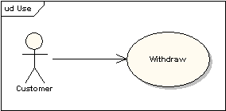
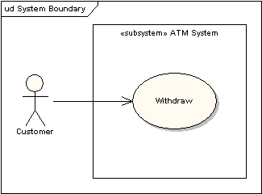
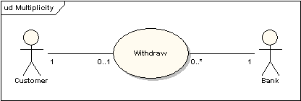
Use Case Modeling
Use Case Diagram

Slide 27
Use Case Modeling
Use Case Specification
name, short purpose, contact and change information
pre-, post - conditions
basic flow is the "good day" scenario
alternate scenarios
Inclusion, extension points to be identified
Activity Diagram
Captures dynamic behavior (activity-oriented)
Purpose
Model business workflows
Model operations

Slide 28
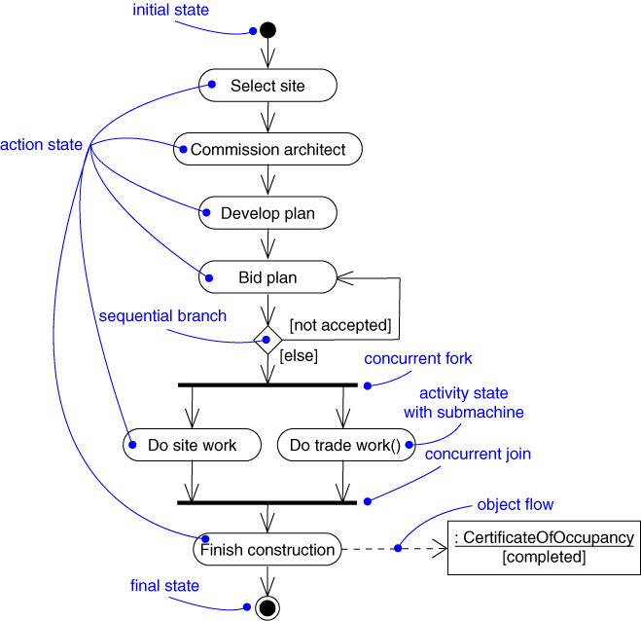
Use Case Modeling – Activity Diagram
Captures dynamic behavior (activity-oriented)

Slide 29
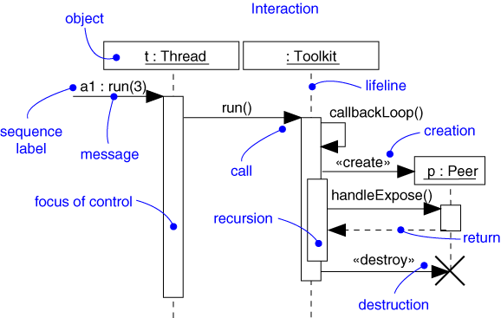
Sequence Diagram
Captures dynamic behavior (time-oriented)

Slide 30
Sequence Diagram
Captures dynamic behavior (time-oriented)
Purpose
Model flow of control
Illustrate typical scenarios

Slide 31
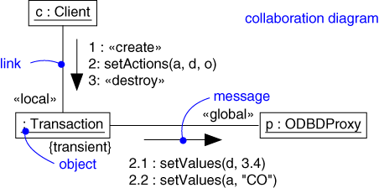
Collaboration Diagram
Captures dynamic behavior (message-oriented)

Slide 32
Collaboration Diagram
Captures dynamic behavior (message-oriented)
Purpose
Model flow of control
Illustrate coordination of object structure and control

Slide 33
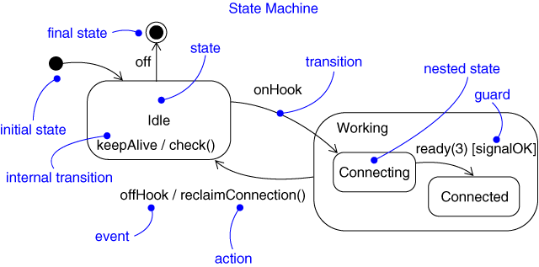
State Chart Diagram
Captures dynamic behavior (event-oriented)

Slide 34
State Chart Diagram
Captures dynamic behavior (event-oriented)
Purpose
Model object lifecycle
Model reactive objects (user interfaces, devices, etc.)

Slide 35
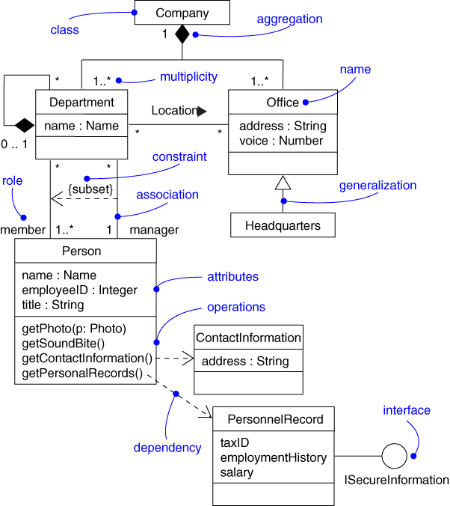
Class Diagram
Captures the vocabulary of a system

Slide 36
Class Diagram
Captures the vocabulary of a system
Built and refined throughout development
Purpose
Name and model concepts in the system
Specify collaborations
Specify logical database schemas
Developed by analysts, designers, and implementers

Slide 37
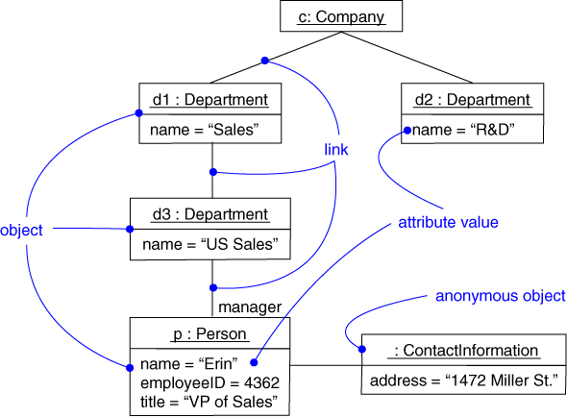
Object Diagram
Captures instances and links

Slide 38
Object Diagram
Shows instances and links
Built during analysis and design
Purpose
Illustrate data/object structures
Specify snapshots
Developed by analysts, designers, and implementers

Slide 39
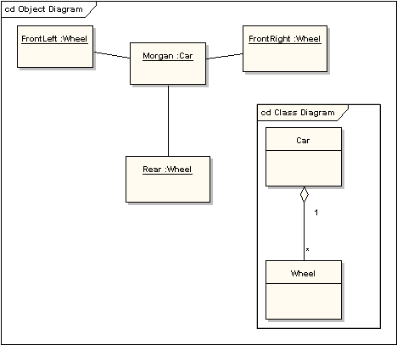
Relationship Between Object and Class Diagram

Slide 40
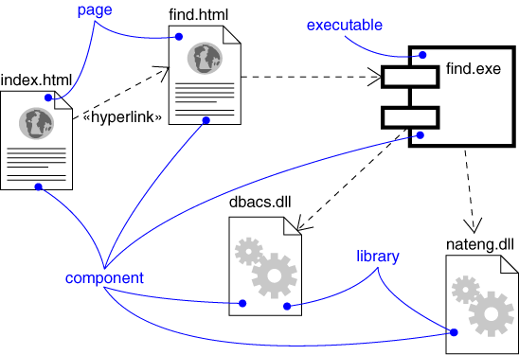
Component Diagram
Captures the physical structure of the implementation

Slide 41
Component Diagram
Captures the physical structure of the implementation
Built as part of architectural specification
Purpose
Organize source code
Construct an executable release
Specify a physical database
Developed by architects and programmers

Slide 42
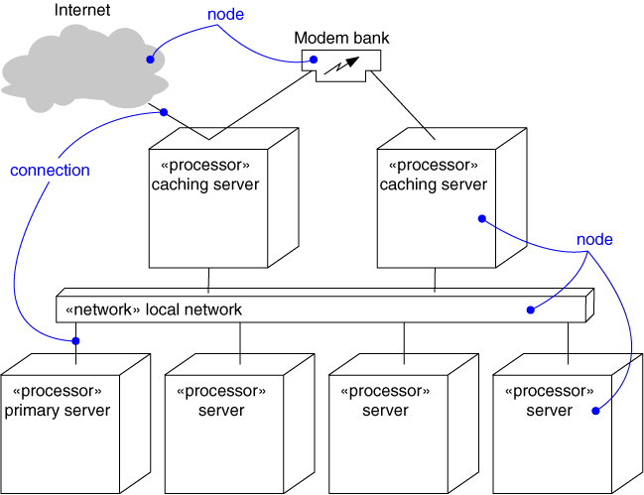
Deployment Diagram
Captures the topology of a system’s hardware

Slide 43
Deployment Diagram
Captures the topology of a system’s hardware
Built as part of architectural specification
Purpose
Specify the distribution of components
Identify performance bottlenecks
Developed by architects, networking engineers, and system engineers

Slide 44
Visual Modeling using UML Diagrams
Use case diagram
Statechart diagram
Class diagram
Actor A
Use Case 1
FileMgr
add( )
DocumentList
Document
Actor B
fetchDoc( )
delete( )
name : int
sortByName( )
docid : int
numField : int
get( )
read() fill the
Use Case 2
open( )
code..
close( )
FileList
read( )
fList
sortFileList( )
create( )
add( )
fillDocument( )
delete( )
1
Use Case 3
1
rep
File
Deployment diagram
Repository
(from Persistence)
read( )
GrpFile
name : char * = 0
read( )
readDoc( )
open( )
Collaboration diagram
readFile( )
create( )
fillFile( )
Repository
DocumentList
FileManager
Window95
Windows95
Windows95
Document
¹®¼­°ü¸®
Å¬¶óÀÌ¾ðÆ®.EXE
Windows
¹®¼­°ü¸® ¾ÖÇÃ¸´
NT
Solaris
GraphicFile
¹®¼­°ü¸® ¿£Áø.EXE
Alpha
File
FileList
Windows
ÀÀ¿ë¼­¹ö.EXE
UNIX
NT
IBM
Mainframe
Component diagram
µ¥ÀÌÅ¸º£ÀÌ½º¼­¹ö
Target
System
Forward and Reverse Engineering
Sequence diagram

Slide 45
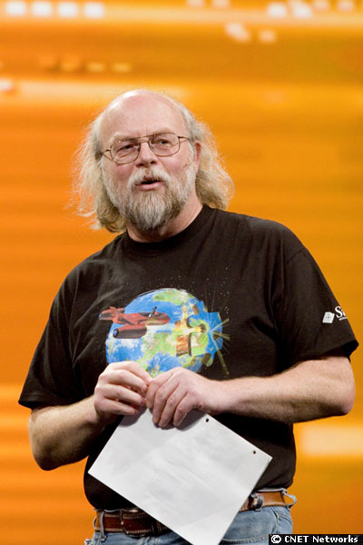
Question – Who is the gentlemen in the picture ??
James Gosling is generally credited as the inventor of the Java programming language in 1994. He did the original design of Java and implemented its original compiler and virtual machine.
Sun Fellow
http://blogs.sun.com/jag/

Slide 46
OOAD

Slide 47
Object Oriented Analysis
Activities:
Finding the objects
Organizing the objects
Describing object interaction
Defining operations on the objects
Defining the object’s internals
Obtain understanding of system based on functional requirements
Considers functional requirements & data as integrated objects
Boundary
Entity
Control

Slide 48
Object Oriented Analysis - Activities
Finding the Objects
Nouns in problem statement
Easy to find objects
difficult to know what is relevant
Find essential objects
Organizing the Objects
Exploring similarity between classes of objects
Organizing Classes into hierarchy
Inheritance
Whole / part
Association

Slide 49
Object Oriented Analysis - Activities
Object Interaction
Scenarios or use cases provide insight - which objects work together
Helps to define Object interface
Operations on Objects
Simple primitive operations based on the interface
Avoid creating complex objects
Object Implementation / Internals
Information to be held, alternate ways of storing
Number of instances of the object
Attributes may be inherited

Slide 50
OO Design
Derive design classes from Analysis model
Design for Non-functional requirements
Performance, memory, response time, etc.
Traceability of Objects
Create & use Components

Slide 51
OO Design – Key Considerations
Coupling
inheritance Vs. coupling
Strong coupling complicates a system
design for weakest possible coupling
Cohesion
degree of connectivity among the elements of a single module/class
coincidental cohesion: all elements related undesirable
Functional cohesion: work together to provide well-bounded behavior

Slide 52
SOFTWARE DEVELOPMENT PROCESS

Slide 53
What is a Process ??
Defines Who is doing What, When to do it, and How to reach a certain goal.
New or changed
requirements
New or changed
system
Software Engineering
Process

Slide 54
Rational Unified Process
Inception
Elaboration
Construction
Transition
time
Inception Define the scope of the project and develop business case
Elaboration Plan project, specify features, and baseline the architecture
Construction Build the product
Transition Transition the product to its users

Slide 55
Iterations and Workflow
In an iteration, you walk through workflows
Phases
Inception
Elaboration
Construction
Transition
Process Workflows
Requirements
Analysis & Design
Implementation
Test
Deployment
Supporting Workflows
Configuration & Change Management
Project & Process Management
Iter. #-1
Iter. #2
Iter. #1
Iter. #2
Iter. #n
Iter. #n+1
Iter. #n+2
Iter. #m
Iter. #m+1
Iterations

Slide 56
Each Iteration Is a Mini-waterfall
time
Requirements
UML diagrams provide views into each model
Use Case Model
Analysis & Design
realized by
Design Model
implemented by
Implementation
Implementation Model
verified by
Test
Test Model

Slide 57
Project Procedure & Artifacts
Prepare Functional Requirements
Business Analyst
Prepare
Use cases
Prepare Business Class Diagram
Prepare Business Activity Diagram
Prepare GUI Design
Business Architect
Review
Use cases
Reviewer (User)
Prepare
Class Diagrams
Prepare Sequence/Collaboration Diagram
Technical Architect
Prepare Component Specification
Lead Developer
Technical Architect
Develop
Components

Slide 58
QUESTIONS ??? Biju.Shoolapani@cognizant.com THANK YOU

Slide 59
Thank you

Slide 60
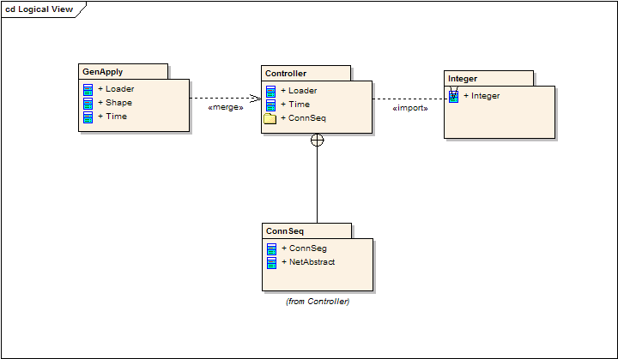
Package Diagrams
Package Merge A «merge» connector between two packages defines an implicit generalization between elements in the source package, and elements with the same name in the target package. The source element definitions are expanded to include the element definitions contained in the target. The target element definitions are unaffected, as are the definitions of source package elements that don't match names with any element in the target package.
Package Import The «import» connector indicates that the elements within the target package, which in this example is a single class, use unqualified names when being referred to from the source package. The source package's namespace gains access to the target classes; the target's namespace is not affected.
Nesting Connectors The nesting connector between the target package and source packages shows that the source package is fully contained in the target package.

Slide 61
Package Diagrams
Package Merge A «merge» connector between two packages defines an implicit generalization between elements in the source package, and elements with the same name in the target package. The source element definitions are expanded to include the element definitions contained in the target. The target element definitions are unaffected, as are the definitions of source package elements that don't match names with any element in the target package.
Package Import The «import» connector indicates that the elements within the target package, which in this example is a single class, use unqualified names when being referred to from the source package. The source package's namespace gains access to the target classes; the target's namespace is not affected.
Nesting Connectors The nesting connector between the target package and source packages shows that the source package is fully contained in the target package.

